Slide 1









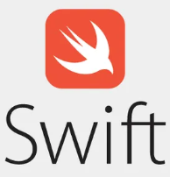

Abridge AI: Elevating Healthcare Conversations with Cutting-edge precision
A pioneer in transformative healthcare experiences through precise medical conversation transcription, analysis, and insights partnered with Sedin to digitally enhance patient-doctor interaction.
Sedin extensively researched React Native design patterns and best practices to keep the app current, while also translating the C-based libflac library to the latest technologies.
Challenge
Benefits
​Patients face challenges in understanding real-time conversations with their doctors.
There is also a need for solutions that enable recording, real-time transcription, and improved understanding of medical-specific terminologies during medical interactions.​
  85% accuracy in conversation transcription
  Immediate review, improving efficiency by over 90%
  100% uninterrupted sessions
Solution
Full-spectrum application launch management ​for iOS and Android native apps
Robust uninterrupted recording capabilities​
Real-time dynamic audio streaming​ to generate real time insights and transcripts
Cutting edge speech transcription, with a key summary tailored for medical jargon understanding
Automated highlights and explanations for medical jargons​
HIPAA compliant assurance
Technologies
Notes:
Benefits need to be relooked at to move some points to Solution section
I think there is also a key summary based on the coversation that is generated. Please check
Is 75% accuracy good?

